Slide 1
TreatmentPatterns tutorial
Maarten van Kessel
m.l.vankessel@erasmusmc.nl
OHDSI Global 2024

Slide 2
Disclosure
This presentation represents the views of the DARWIN EU® Coordination Centre only and cannot be interpreted as reflecting those of the European Medicines Agency or the European Medicines Regulatory Network.

Slide 3
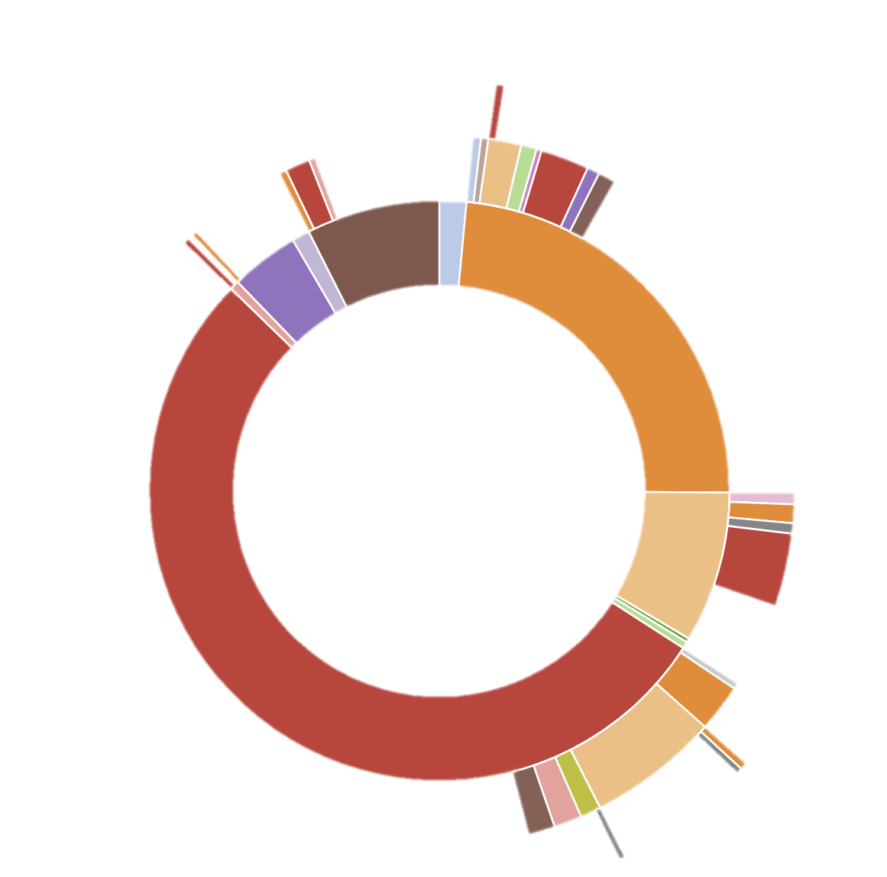
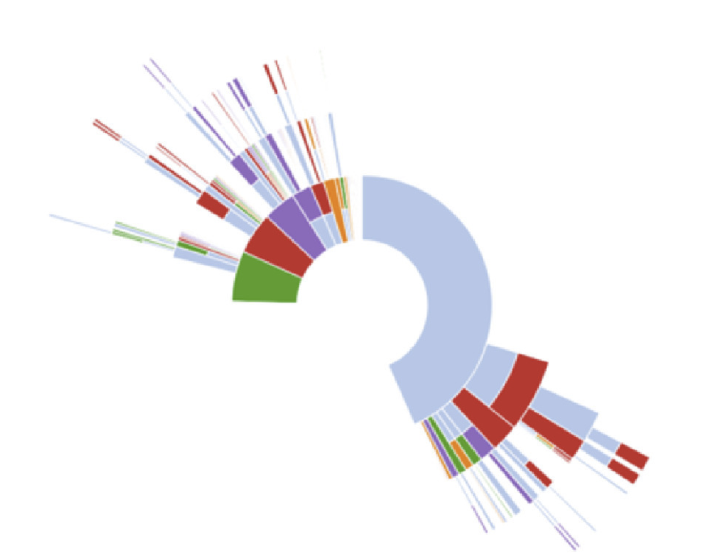

Slide 4
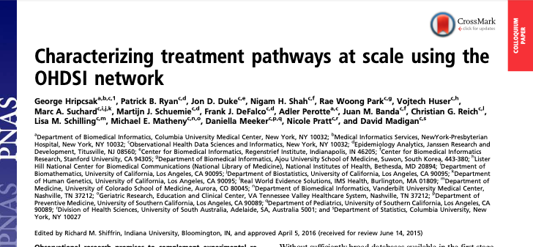
https://www.pnas.org/doi/10.1073/pnas.1510502113 https://www.ohdsi.org/web/wiki/doku.php?id=research:treatment_pathways_in_chronic_disease
https://github.com/OHDSI/StudyProtocols/blob/master/Study%201%20-%20Treatment%20Pathways/R%20Version/TxPath%20parameterized.sql

Slide 5
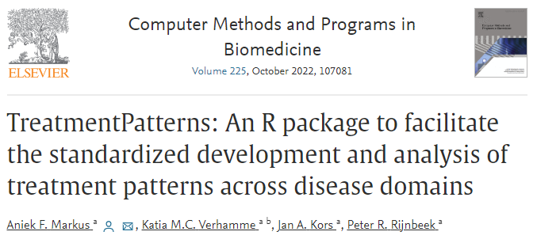
https://www.sciencedirect.com/science/article/pii/S016926072200462X?via%3Dihub

Slide 6
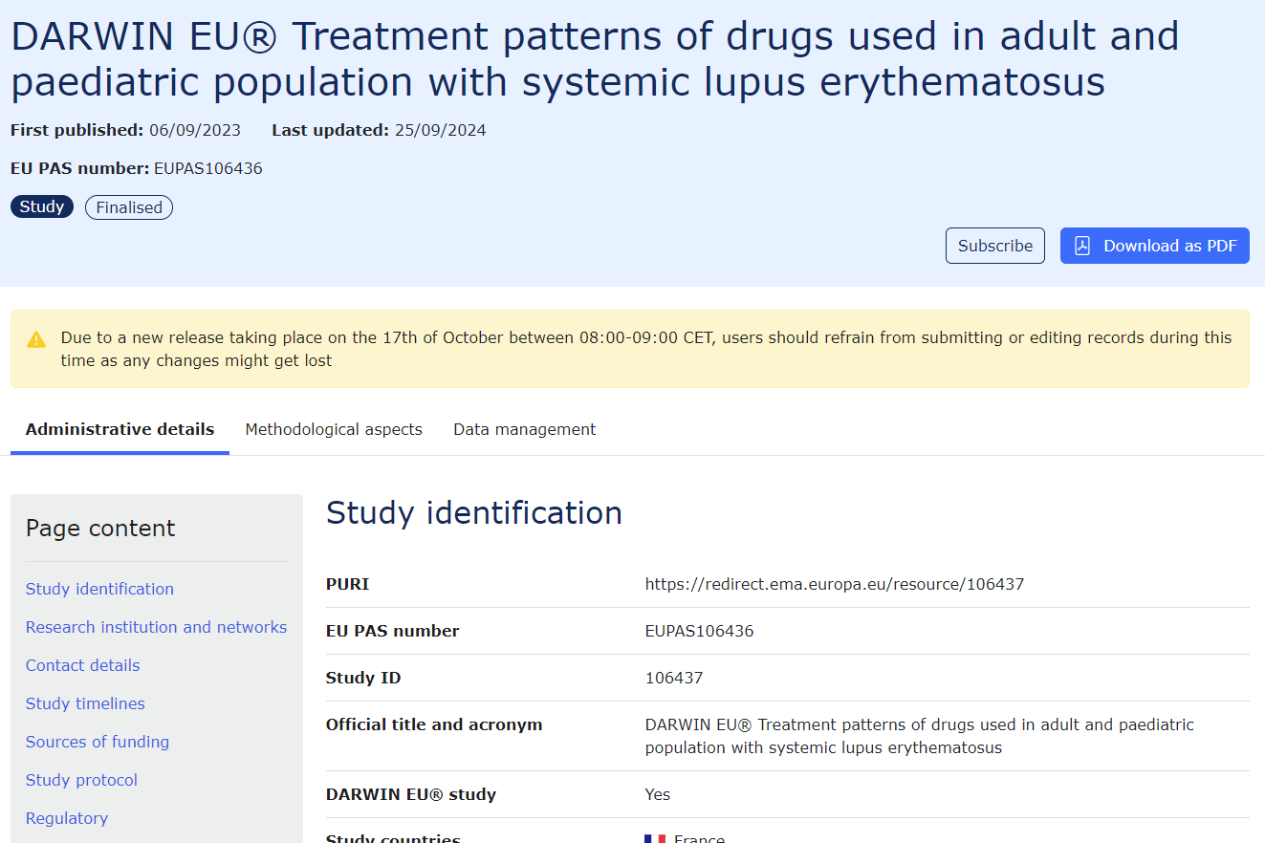
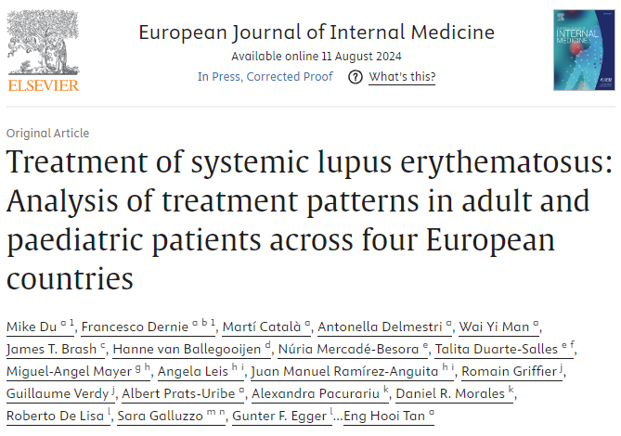
https://catalogues.ema.europa.eu/node/3800/administrative-details
https://www.sciencedirect.com/science/article/pii/S0953620524003443

Slide 7
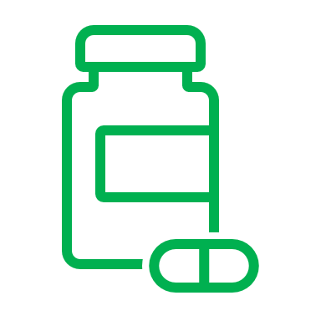
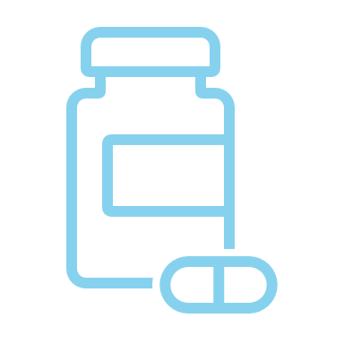
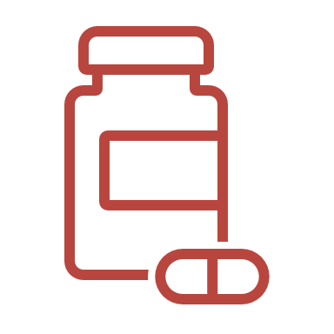

Treatment Patterns Study
A treatment pathway is a sequence of events (treatments).
Problem definition: find the treatment pathway consisting of treatments of interest (event cohorts) within a certain study population (target cohort).
Person A
Person B

Slide 8
Cohort of people
One Person
A
A+B
B
A+B
A
B
A

Slide 9
A
A+B
B
A
A
B

Slide 10
eraCollapseSize
combinationWindow
A¹
A²
B
minEraDuration
minPostCombinationDuration
C
D
C
C+D
D
C+D

Slide 11



Cohort Definition
Cohort Generation & database interface
Computing Pathways
Export Sharable data
CDMConnector
computePathways()
export()
SQL

Slide 12
https://github.com/oxford-pharmacoepi/darwinTutorial2024
https://posit.cloud/spaces/562431/content/8885073

